Slide 1







Big Data Analysis
Team Project Proposal

Slide 2


Les ptits chou
YANNICK FERRARD
VALENTIN EYRAUD
Team Leader
Team Member
JULIAN NDENDE
RENAN DUBOIS
Team Memeber
Team member

Slide 3


Our topic
In the world of Twitch streaming, data analytics is a game-changer. It's the key to understanding your audience, refining content, and optimizing platform performance. By analyzing metrics like viewer demographics and engagement, streamers and platforms can enhance the streaming experience for all. Let's explore how data analytics is reshaping the Twitch landscape.

Slide 4


Why we choose this topic
Enhanced Content Diversity:
By understanding audience preferences and trends through data analysis, content creators can produce a wider variety of content that caters to diverse interests and communities, fostering inclusivity and representation.`
Community Building and Connection:
Data-driven insights enable streamers to foster stronger connections with their audience by tailoring content and engagement strategies to meet their viewers' preferences and needs, thereby building more vibrant and supportive online communities.
Economic Opportunities:
Data analytics empowers streamers and platforms to optimize monetization strategies, such as targeted advertising and sponsorships, which not only support content creators financially but also contribute to the broader digital economy.
Educational and informative content:
Insights derived from data analysis can help identify educational or informative content that resonates with audiences, promoting knowledge sharing and skill development within the community.
Platform Improvement and Innovation:
Platforms like Twitch can use data analysis to identify areas for improvement, enhance the user experience, and innovate new features that benefit both content creators and viewers, ultimately driving continuous evolution and improvement within the streaming ecosystem.

Slide 5


Survey
What is a survey ?
What we wanted to find with the survey ?
Impact
Needs
How this survey will help us ?
Guide us in our research
Find some insight

Slide 6
3 Introductions question
Age
Gender
Country of residence

Slide 7
Twitch based question
How often do you watch streams on Twitch?
What motivates you to watch streams on Twitch? (Select all that apply)
How long have you been using Twitch?
How important is Twitch as a source of entertainment in your life?
What impact, if any, has Twitch had on your social life or connections with others?
Do you believe Twitch has influenced your interests or hobbies in any way? If yes, please describe.
In your opinion, why does Twitch matter in the realm of online entertainment and social media?
Would you recommend Twitch to others as a platform for entertainment? Why or why not?
Any additional comments or insights you would like to share regarding your experience with Twitch?

Slide 8

Data analysis tools
1
2
3
Comprehensive Data Access
Real-Time Updates
Customizable Queries
Twitch API

Slide 9
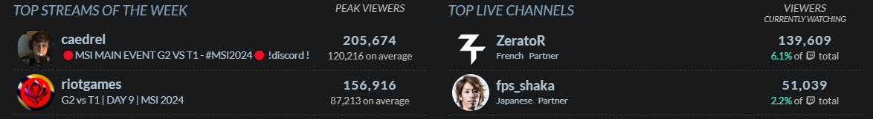

Data analysis tools
1
2
3
Detailed Analytics
Competitive Analysis
Historical Data
TwitchTracker

Slide 10
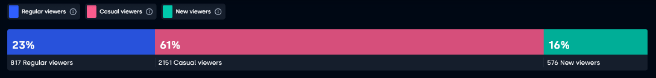

Data analysis tools
1
2
3
Comprehensive Twitch Analytics
Audience Engagement Insights:
Customizable Dashboards and Report
StreamBee

Slide 11

Conclusion
In conclusion, conducting a survey on data analytics for Twitch streaming promises to shed light on key aspects of viewer engagement, content preferences, and platform usability. By following a comprehensive plan of action, we aim to gather valuable insights that will empower content creators and platform administrators to make informed decisions, optimize strategies, and enhance the overall streaming experience. As we embark on this journey, we anticipate that the findings from the survey will not only benefit individual streamers but also contribute to the broader evolution and improvement of the Twitch platform, shaping the future of online entertainment in profound ways.

Slide 12
Thank You

